Slide 1
Telecommunications Industry Association (TIA) | TR42.7-2021-02-006a
October 26 , 2020
DOCUMENT SUBMITTED TO: TR-42 Meeting
The document to which this cover statement is attached is submitted to a Formulating Group or sub-element thereof of the Telecommunications Industry Association (TIA) in accordance with the provisions of Sections 3.3.2 Submissions and Contributions inclusive of the TIA Engineering Committee Operating Procedures (ECOP) dated July 7, 2015, all of which provisions are hereby incorporated by reference.
SOURCE: | Shinji Hinoshita (Mr.)
CONTACT: | Chief Engineer (Japan National Certificate for Tx. Ex. & LINE PLANT) 3-36-7 Kawajiri-Cho, Hitachi City Japan, 319-1444 Telephone: +81-294-42-9459 Mobile: +81-80-1383-4597 Email: hinos@crocus.ocn.ne.jp
TITLE: | Study of limitation of stranded conductor for Cat. 6A patch cord due to H2O diffusion
PROJECT NUMBER (PN): | NA
DISTRIBUTION: | TR-42.7
INTENDED PURPOSE OF DOCUMENT: | ___ | FOR INCORPORATION INTO TIA PUBLICATION
 | __X_ | FOR INFORMATION
 | Amendment | TIA 568.2-D, relevant clause of stranded conductor stipulation.
ABSTRACT: Presentation of revised formulas of loss, Zc and Le with calculation result. Zc increase causes due to Le frequency dependency, which is derived by H2O molecular diffusion into strand gap.
PATENT DISCLOSURE (OPTIONAL) The Source may have patent(s) and/or published pending patent application(s) that may be essential to the practice of all or part of this Contribution as incorporated in a TIA Publication, and the Source is willing to comply with Section 3.2 Intellectual Property Rights (IPR) Policy of the TIA Engineering Committee Operating Procedures (ECOP) dated July 7, 2019 as to such patent(s) and/or published pending patent application(s).

Slide 2
Detail Study of Loss (α) and Characteristic Impedance (Zc) Calculation
By the revised & detailed calculation formula for following cables
(Calculation is conducted by Referenced Excel File presented as separated file.)
Study result of Stranded Conductor Aging;
Tanδ and Equivalent Volume Resistivity (ρ) increase effect for Zc is very minor.
External Inductance (Le) increases according to high frequency resistance (Rs) increase, namely equivalent
volume resistivity (ρ) increase might be the real cause of Zc increase due to moisture aging of stranded
conductor.
(External Inductance (Le) of stranded conductor has frequency dependence when H2O molecular diffused
into strand gaps during life aging.)
Le increase level (increase limit) shall be validated by the data of sample cables aged by accelerating condition,
85 deg-C, 85 R/H-% for 30 days since the external magnetic field flux change might be limited between the
constant distance of pair conductors. Le=(μ0/4π)(4ln(D/r)+μ), where r is equivalent radius of stranded conductor.

Slide 3
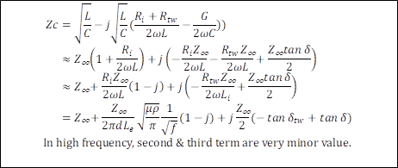
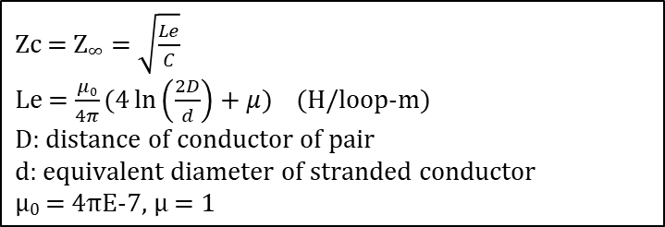
Revised & Detailed Calculation Formula of Loss (α) and Characteristic Impedance (Zc)

Slide 4
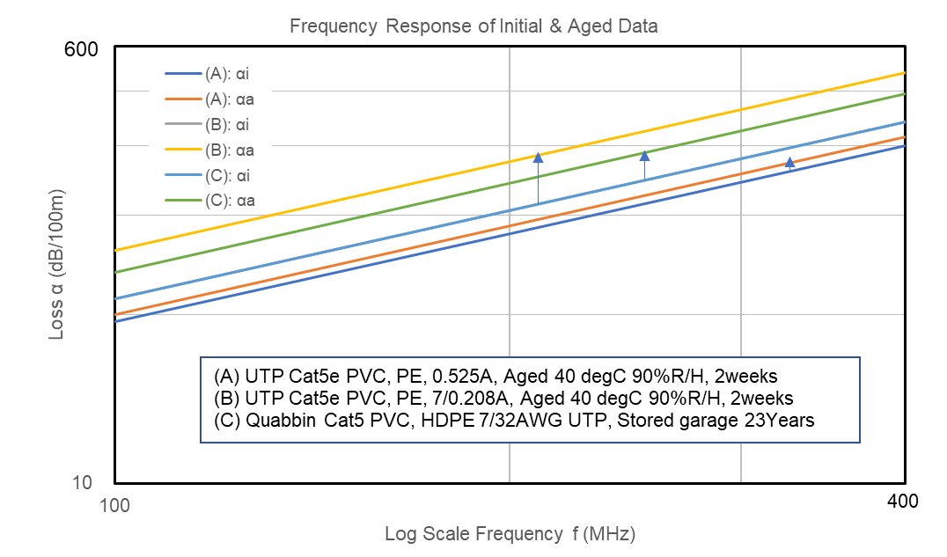
Measured Data of Initial Loss (αi) and Aged Loss (αa), Initial Data of (C) is assumed as Initial Data of (B).

Slide 5
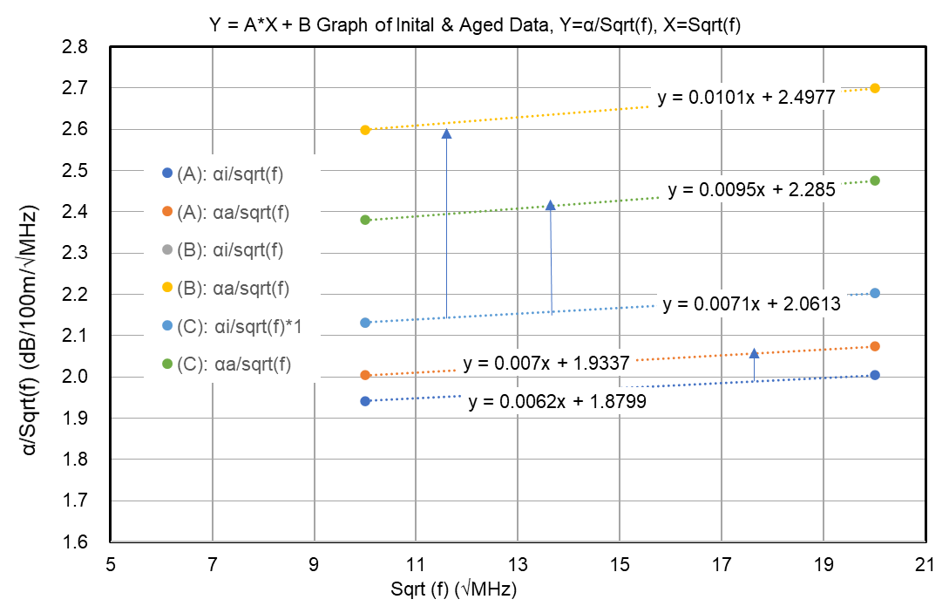
A & B parameters of Y=AX+B are calculated by linear fitting by using 100 & 400 MHz loss Data

Slide 6
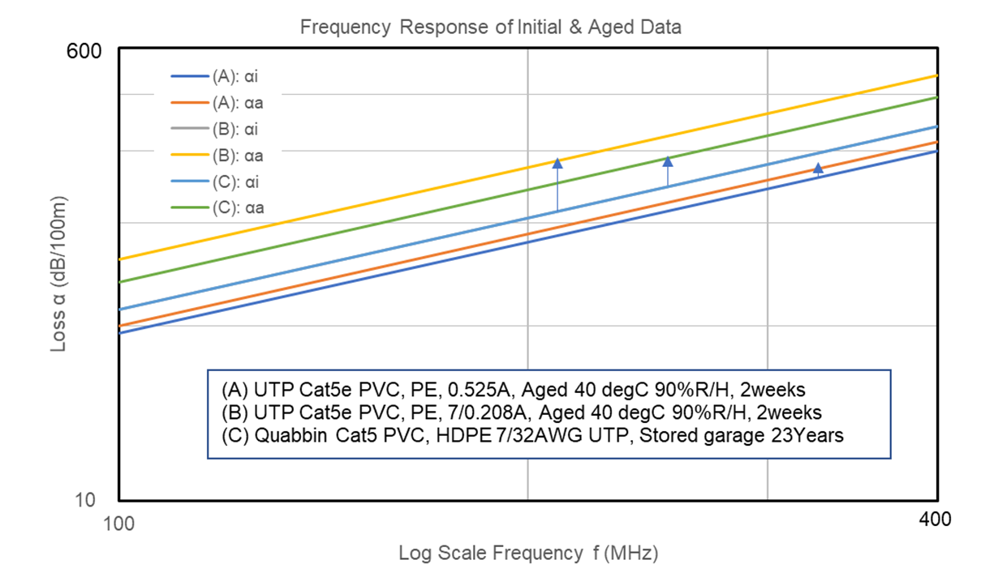
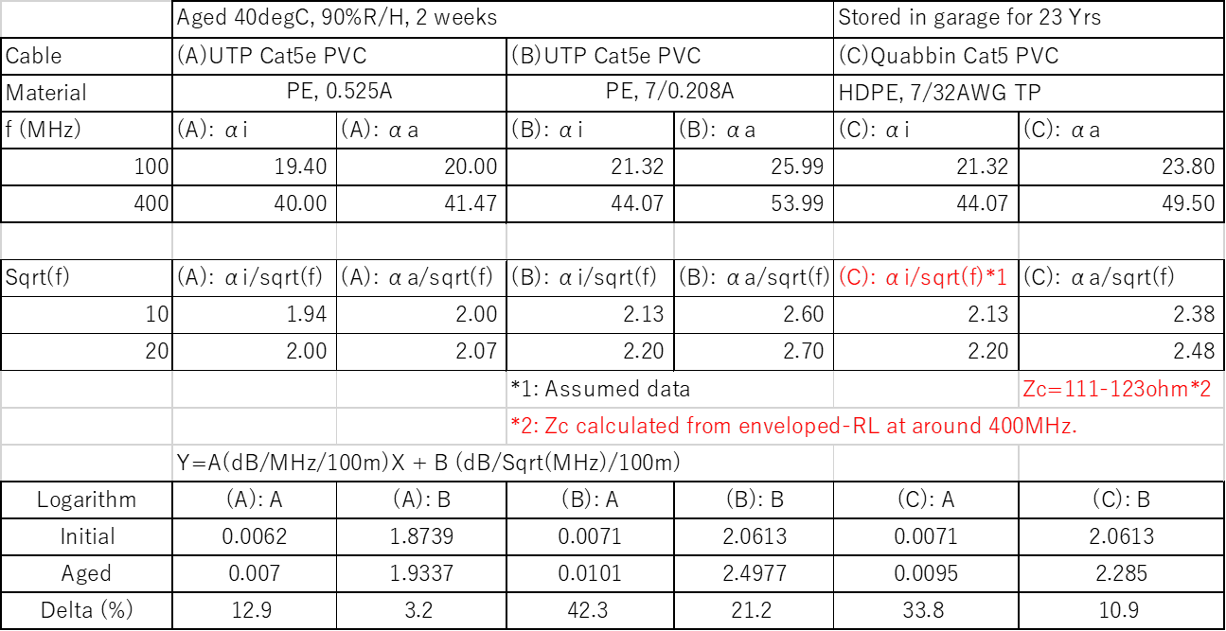
Result of A (dB/MHz/100m) & B (dB/√MHz/100m).
Increase of A & B by Delta (%)

Slide 7
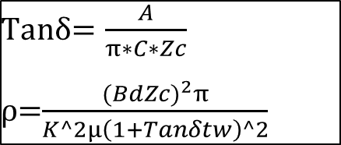
Calculation of physical constant parameters & formula of Tanδ & ρ.
K value is decided from B value calculation to fit B value (e.g. 1.87) by K value try input repeating.

Slide 8
Unit, Neper Converted Result of A (Neper/MHz/100m) & B (Neper/√MHz/100m) for Loss, Tanδ & ρ Calculation.
Increase of Tanδ & Equivalent Volume Resistivity ρ by Delta (%)

Slide 9
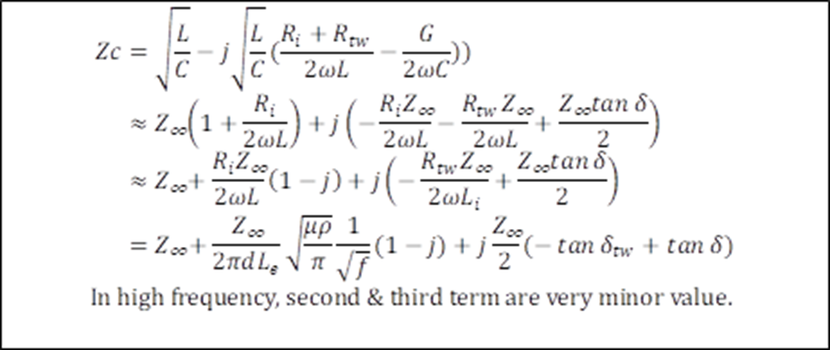
Zc increase by Tanδ & ρ is very minor by 1/sqrt(f), f in Hz (e.g. f=100MHz, f=1E08(Hz), of 2nd term and
Tanδ (e.g. 1.38E-3) of 3rd term.
Calculation formula, 1st term Z∞ shall be studied. Z∞=Sqrt(Le/C). Le might have frequency increase dependent
‘according to Rs increase.

Slide 10
Characteristic Impedance (Zc), RL & Le are calculated to fit measured data of RL of (C) (stored 23 years) by
‘assuming Le=5.0E-7EXP(0.000065f), f in MHz (Le=0.5mH/km in lower frequency is assumed.).
Equivalent d is calculated. Equivalent d might be decreased according to Rs increase, namely ρ increase.

Slide 11
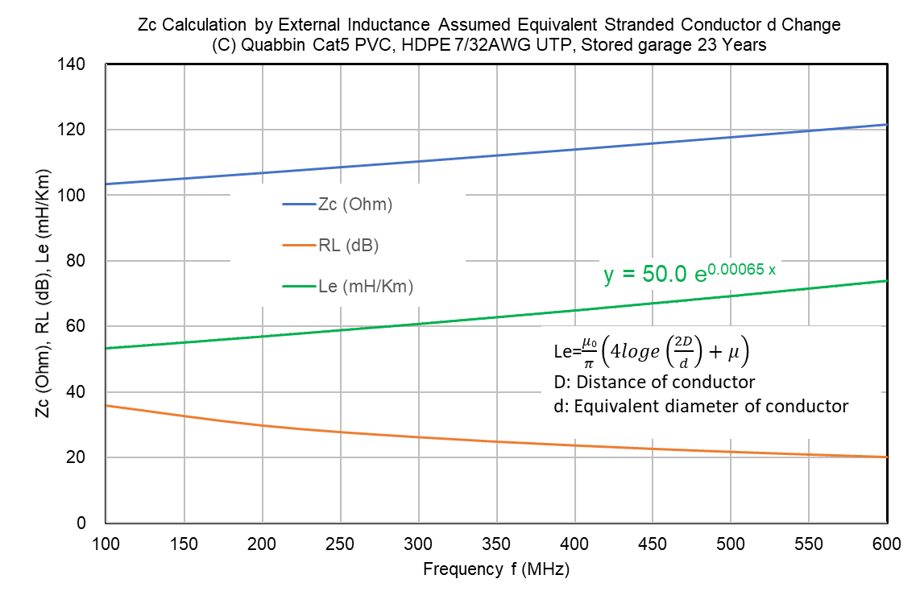
Characteristic Impedance (Zc), RL & Le are calculated to fit measured data of RL of (C) (stored 23 years) by
‘assuming Le=5.0E-7EXP(0.000065f), f in MHz (Le=0.5mH/km in lower frequency is assumed.).
Equivalent d is calculated. Equivalent d might be decreased according to Rs increase namely ρ increase.

Slide 12
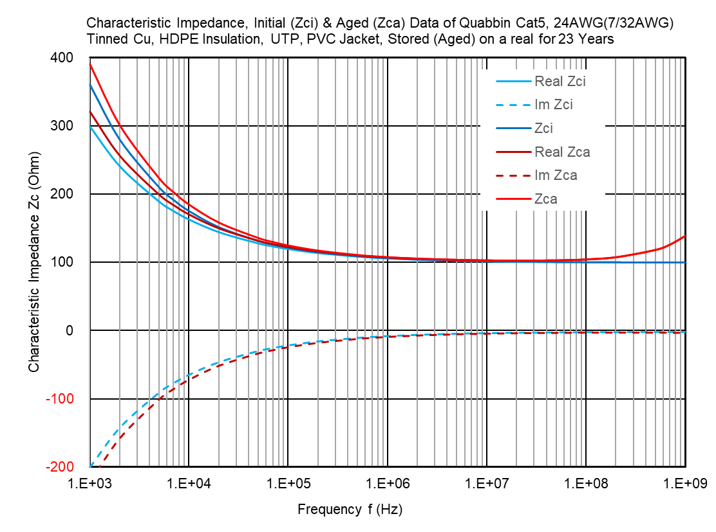

Slide 13
